Slide 1
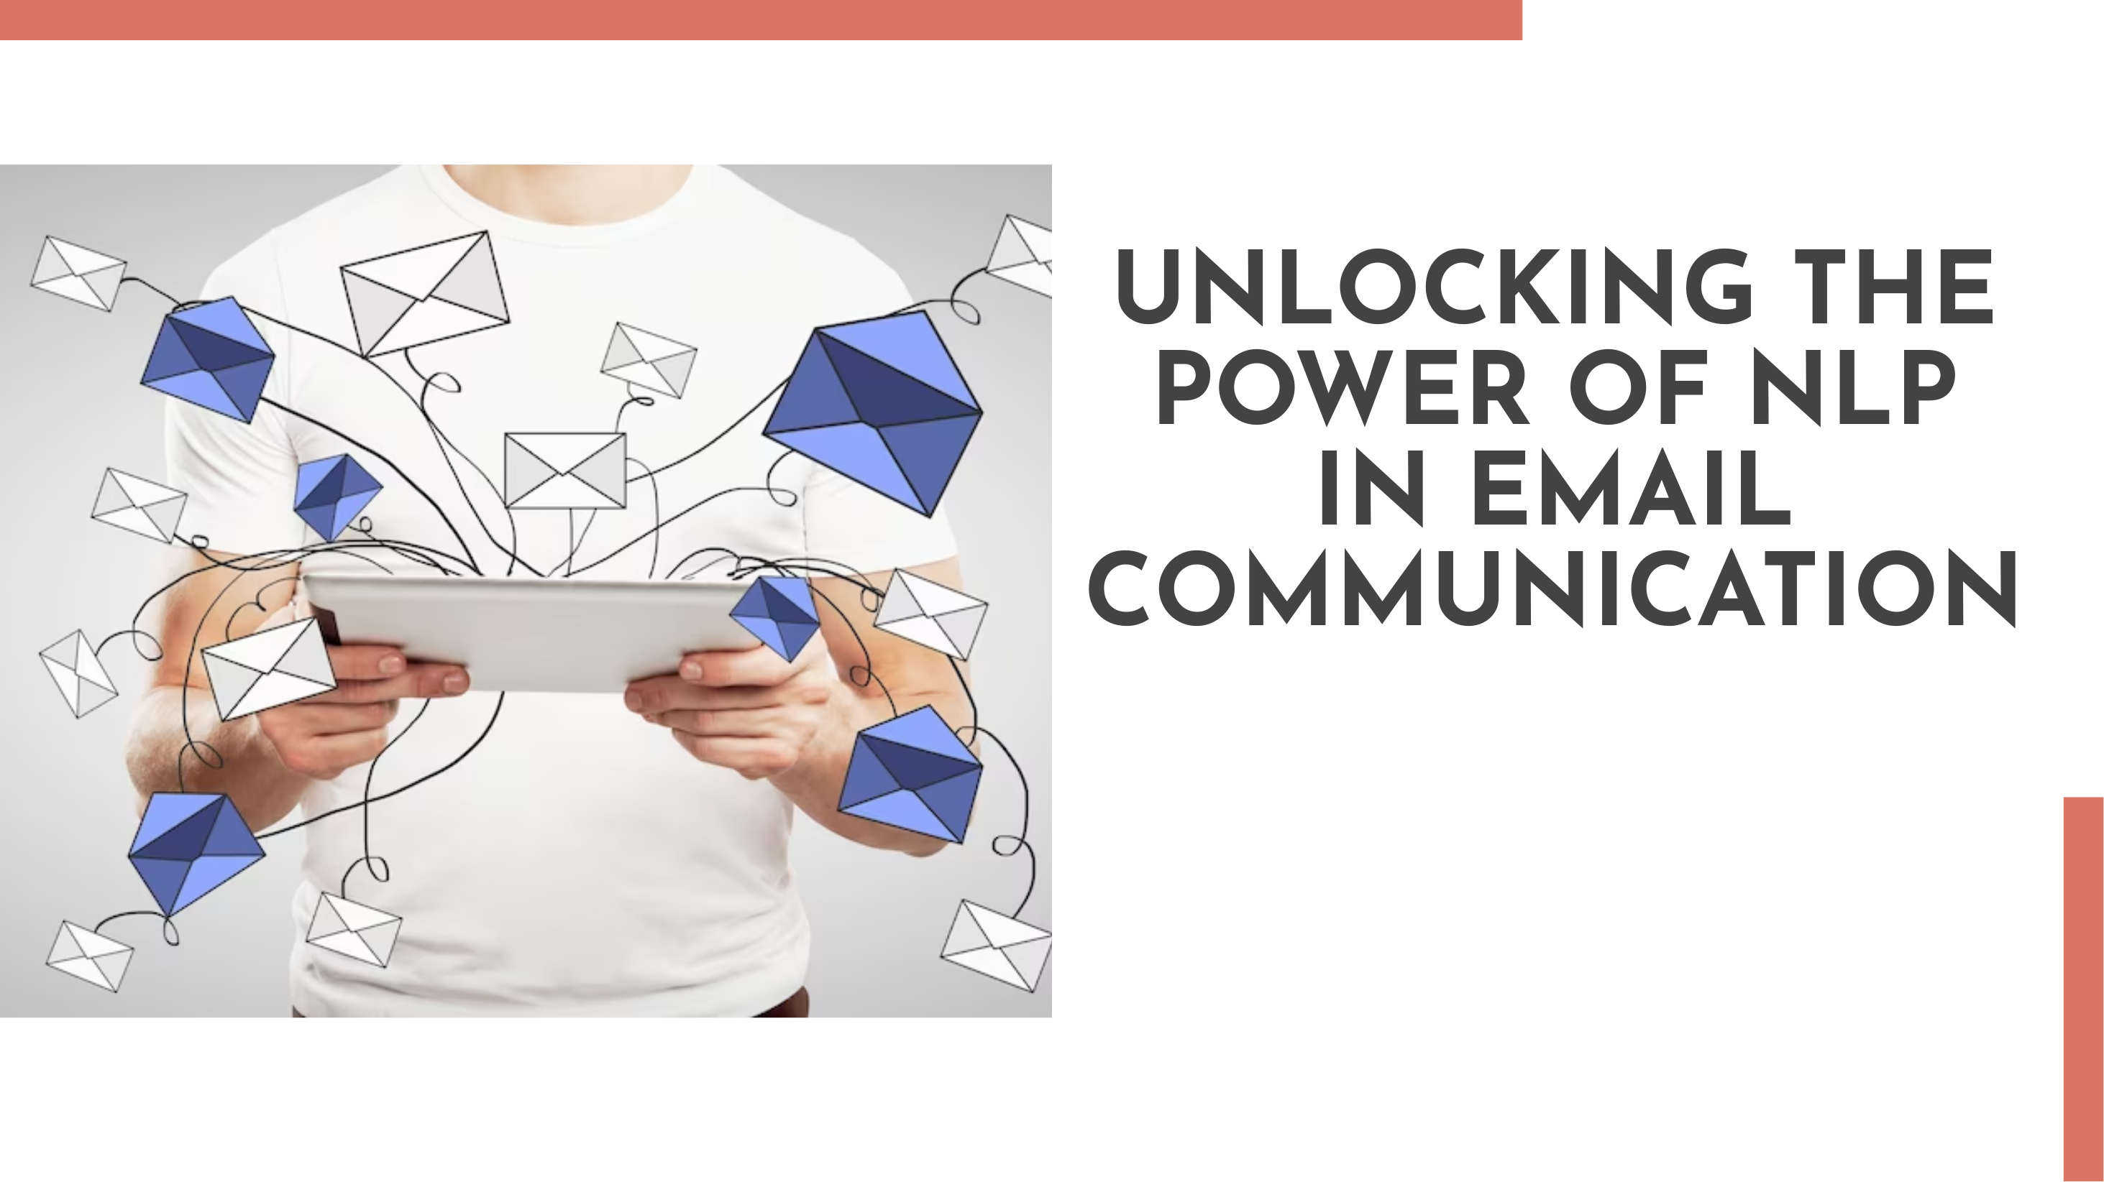
Prepared by : Group 2
Mr. Rohit Gusain
Mrs. Megha Patil
Mansi Dinesh Ahire
Ms. Jyoti Rangnath Bhite

Slide 2
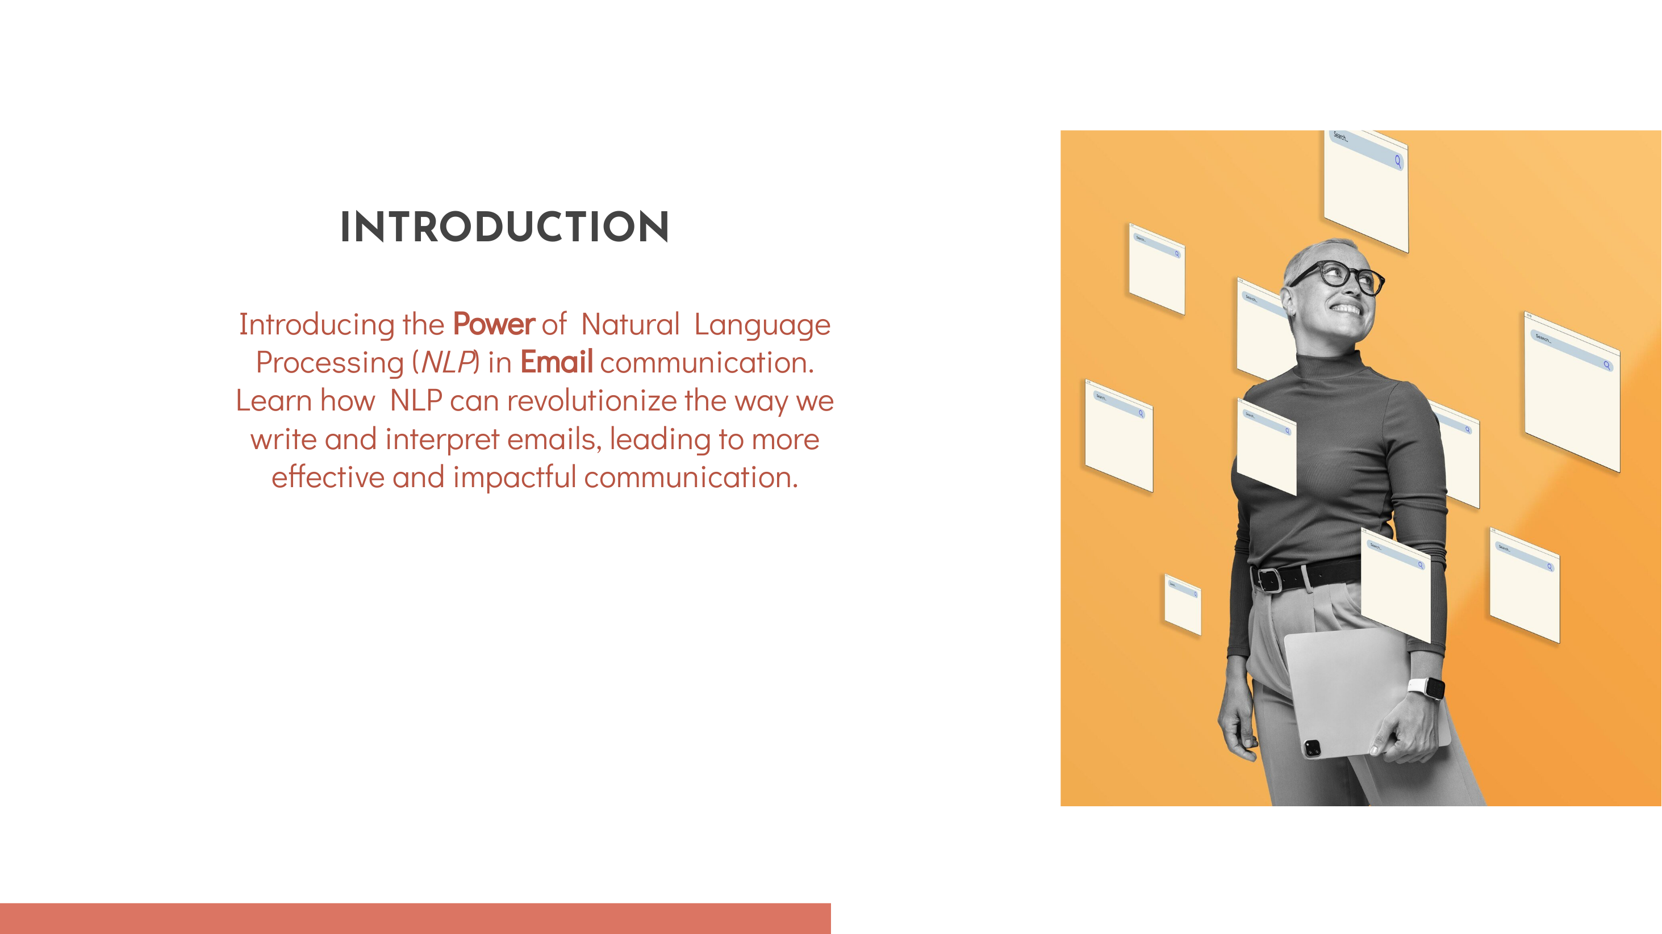
Natural Language Processing, or NLP, is a field of artificial intelligence (AI) that focuses on the interaction between computers and humans through natural language. It enables machines to understand, interpret, and generate human language in a way that is both meaningful and contextually relevant.
Introduction to NLP

Slide 3
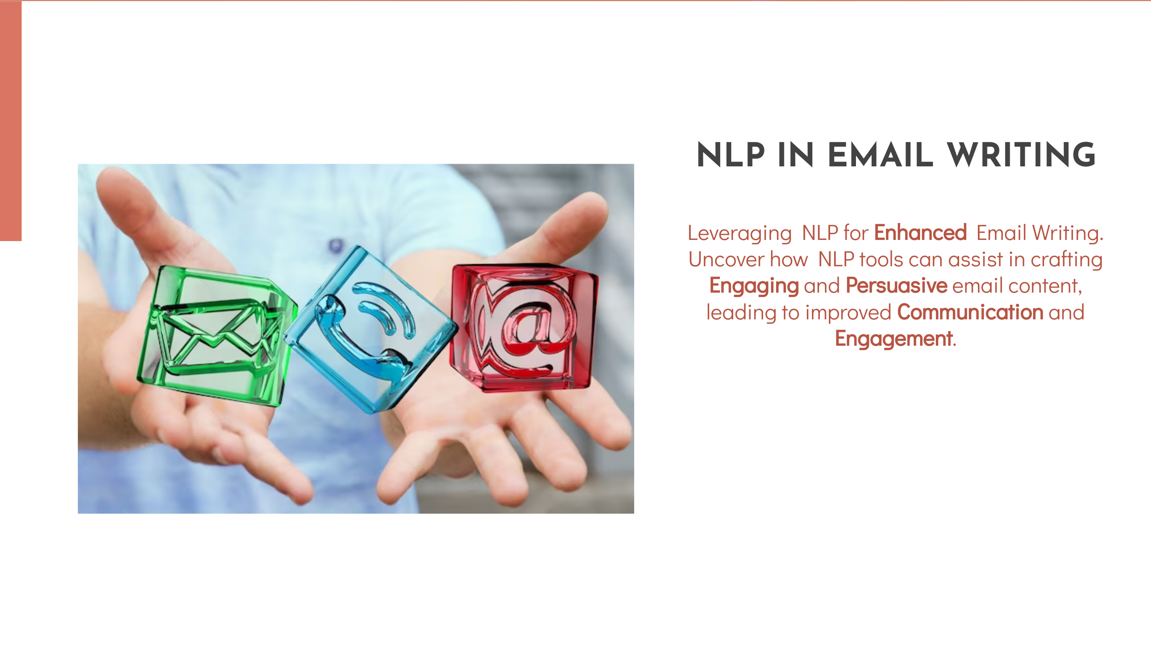
NLP in Emails - Overview
Natural Language Processing (NLP) transforms the way we interact with and understand emails, making communication more efficient and insightful. NLP in emails is revolutionizing communication, making it more intelligent, efficient, and inclusive. As technology continues to advance, we can expect even more sophisticated applications, further enhancing the way we interact with our emails.

Slide 4

Business Objective:
Inappropriate emails would demotivates and spoil the positive environment that would lead to more attrition rate and low productivity and Inappropriate emails could be on form of bullying, racism, sexual favoritism and hate in the gender or culture, in today’s world so dominated by email no organization is immune to these hate emails.
The goal of the project is to identify such emails in the given day based on the above inappropriate content.

Slide 5

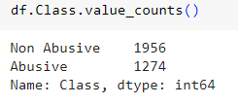
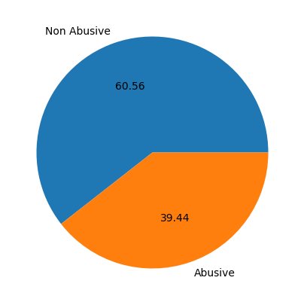
The dataset contains around 20 lakh emails generated by employees of an organization.
Dataset Details

Slide 6

Email Parsing with NLP
The process of breaking down raw email content into structured data using Natural Language Processing (NLP) techniques. It is used to Enhance understanding and facilitate efficient analysis of key components within emails.
Key Steps in Email Parsing:
Tokenization: Segmentation of text into smaller units (tokens) like words or phrases.
Syntactic Parsing: Analysis of grammatical structure for comprehensive interpretation.
Part-of-Speech Tagging: Assigning grammatical categories to each word for contextual understanding.

Slide 7


Benefits of Email Parsing with NLP:
Structured Data: Converts unstructured email content into organized and readable formats.
Precision in Analysis: Allows targeted analysis of specific elements for deeper insights.
Efficient Information Retrieval: Facilitates quick and accurate searching within emails.
NLP Libraries for Email Parsing:
NLTK (Natural Language Toolkit): A comprehensive library for various NLP tasks in Python.
spaCy: Offers pre-trained models for diverse NLP tasks, including parsing.
TextBlob: A user-friendly library for basic textual data processing.

Slide 8

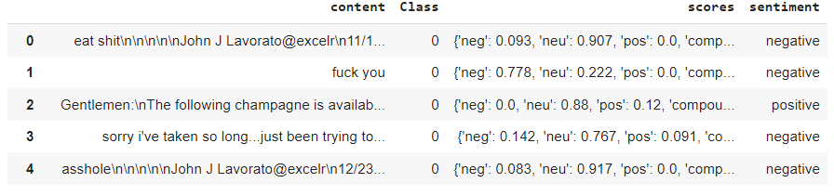
Harnessing the power of NLP for sentiment analysis in email communication. Understanding the ability of NLP to detect positive, negative, and neutral sentiments in emails. Leveraging sentiment analysis for customer feedback and relationship management.
Sentiment Analysis

Slide 9

Streamlit
Streamlit is an open-source Python library that makes it easy to create web applications for data science and machine learning. With Streamlit, you can turn data scripts into shareable web apps in a few lines of code, allowing for rapid prototyping and deployment.
Key features :
Simplicity
Rapid Prototyping
Widgets and Components
Automatic Updating
Wide Data Integration
Customization
Deployment Options

Slide 10
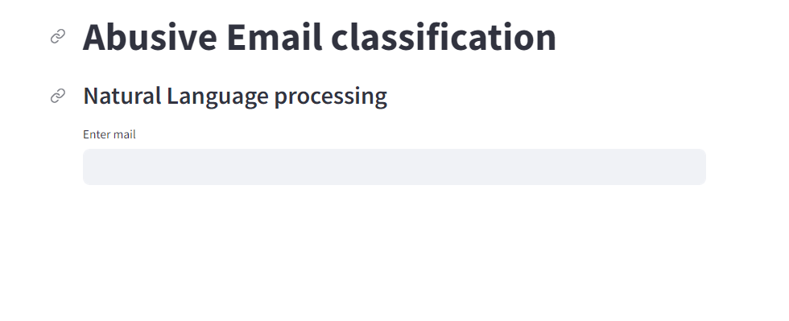
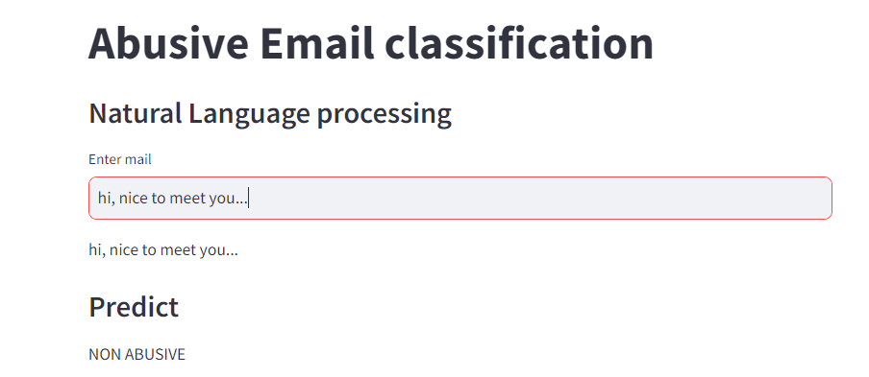
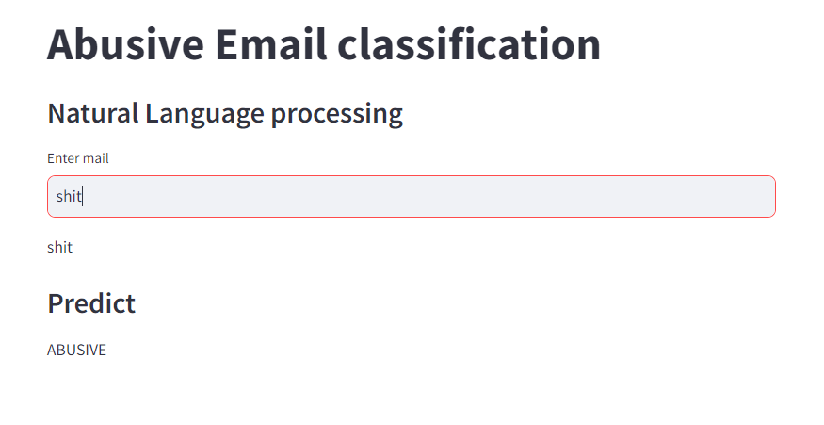
Deployment With Streamlit

Slide 11
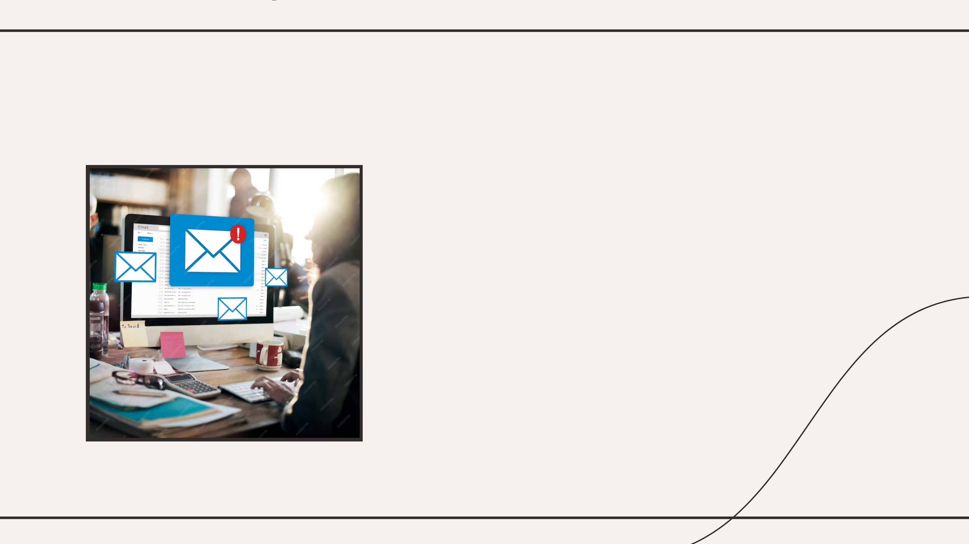
Tools and Technologies used :
General NLP Libraries:
NLTK (Natural Language Toolkit):
A comprehensive library for NLP tasks in Python. It provides tools for tasks such as tokenization, stemming, tagging, parsing, and more.
Machine Learning Frameworks:
scikit-learn:
A simple and efficient library for classical machine learning algorithms in Python. It includes tools for text classification, clustering, and other NLP-related tasks.
Machine learning algorithmns used :
GaussianNB
MultinomialNB
BernauliNB

Slide 12
Challenges in NLP for Emails
Ambiguity and Contextual Variations:
Issue: Natural language is inherently ambiguous, and the meaning of words or phrases can vary based on context.
Challenge: Understanding and disambiguating context-dependent language, especially in emails where the tone and meaning can shift.
Handling Slang and Informal Language:
Issue: Emails often contain informal language, slang, and colloquial expressions.
Challenge: Developing models that can accurately interpret and process these variations without misinterpretation.
Multilingual Content:
Issue: Emails may be written in different languages, adding complexity to language understanding.
Challenge: Designing NLP systems that can handle multilingual content effectively and accurately.
Privacy and Security Concerns:
Issue: Emails often contain sensitive or private information.
Challenge: Ensuring that NLP processes adhere to privacy regulations and security standards, especially when handling personal or confidential data.
Large Volume of Unstructured Data:
Issue: Emails can be lengthy and contain unstructured data.
Challenge: Efficiently processing and extracting meaningful insights from large volumes of unstructured text data in a timely manner.

Slide 13

Future Trends
The future trends for Natural Language Processing (NLP) in email processing are likely to align with broader NLP trends, but with a specific focus on addressing challenges unique to the domain of emails
Here are some future trends for NLP in email:
Advanced Email Summarization
Personalized Email Assistance
Enhanced Email Categorization
Dynamic Email Prioritization
Context-Aware Email Thread Analysis
Multilingual Email Support
Email Sentiment Analysis
Privacy-Focused NLP for Emails
Interactive Email Composing Assistance
Voice-Based Email Interaction

Slide 14
Challenges in NLP for Emails
Subjectivity and Sentiment Analysis:
Issue: Determining the sentiment or emotional tone in emails can be subjective and context-dependent.
Challenge: Developing models that accurately capture the sentiment expressed, considering nuances and sarcasm.
Email Abbreviations and Acronyms:
Issue: Emails often include abbreviations and acronyms specific to certain industries or communities.
Challenge: Building models that can decipher industry-specific language and adapt to evolving trends in abbreviations.
Dynamic Language Evolution:
Issue: Language is constantly evolving with new words and expressions emerging over time.
Challenge: Ensuring NLP models are up-to-date and can adapt to changes in language patterns.
Integration with Existing Systems:
Issue: NLP applications for emails need to seamlessly integrate with existing email systems and workflows.
Challenge: Ensuring compatibility and smooth integration without disrupting the user experience or existing processes.
User Expectations and Interpretation:
Issue: Users may have varied expectations regarding how emails should be processed or interpreted.
Challenge: Striking a balance between automated processing and user customization to meet diverse user expectations.
Lack of Standardization:
Issue: There is no universal standard for email content and structure.
Challenge: Adapting NLP models to handle the diverse formats and structures of emails across different platforms and services.

Slide 15

Conclusion
the integration of Natural Language Processing (NLP) in the context of emails has the potential to revolutionize the way we interact with and manage our electronic communication. NLP brings a suite of capabilities that enhances the efficiency, understanding, and personalization of email processing.
Key takeaways include:
Efficient Information Extraction
Automated Categorization and Prioritization
Personalized Assistance
Multilingual Support:
Challenges and Considerations
Future Directions
Integration with Other Technologies
Holistic Email Solutions:

Slide 16


